Slide 1


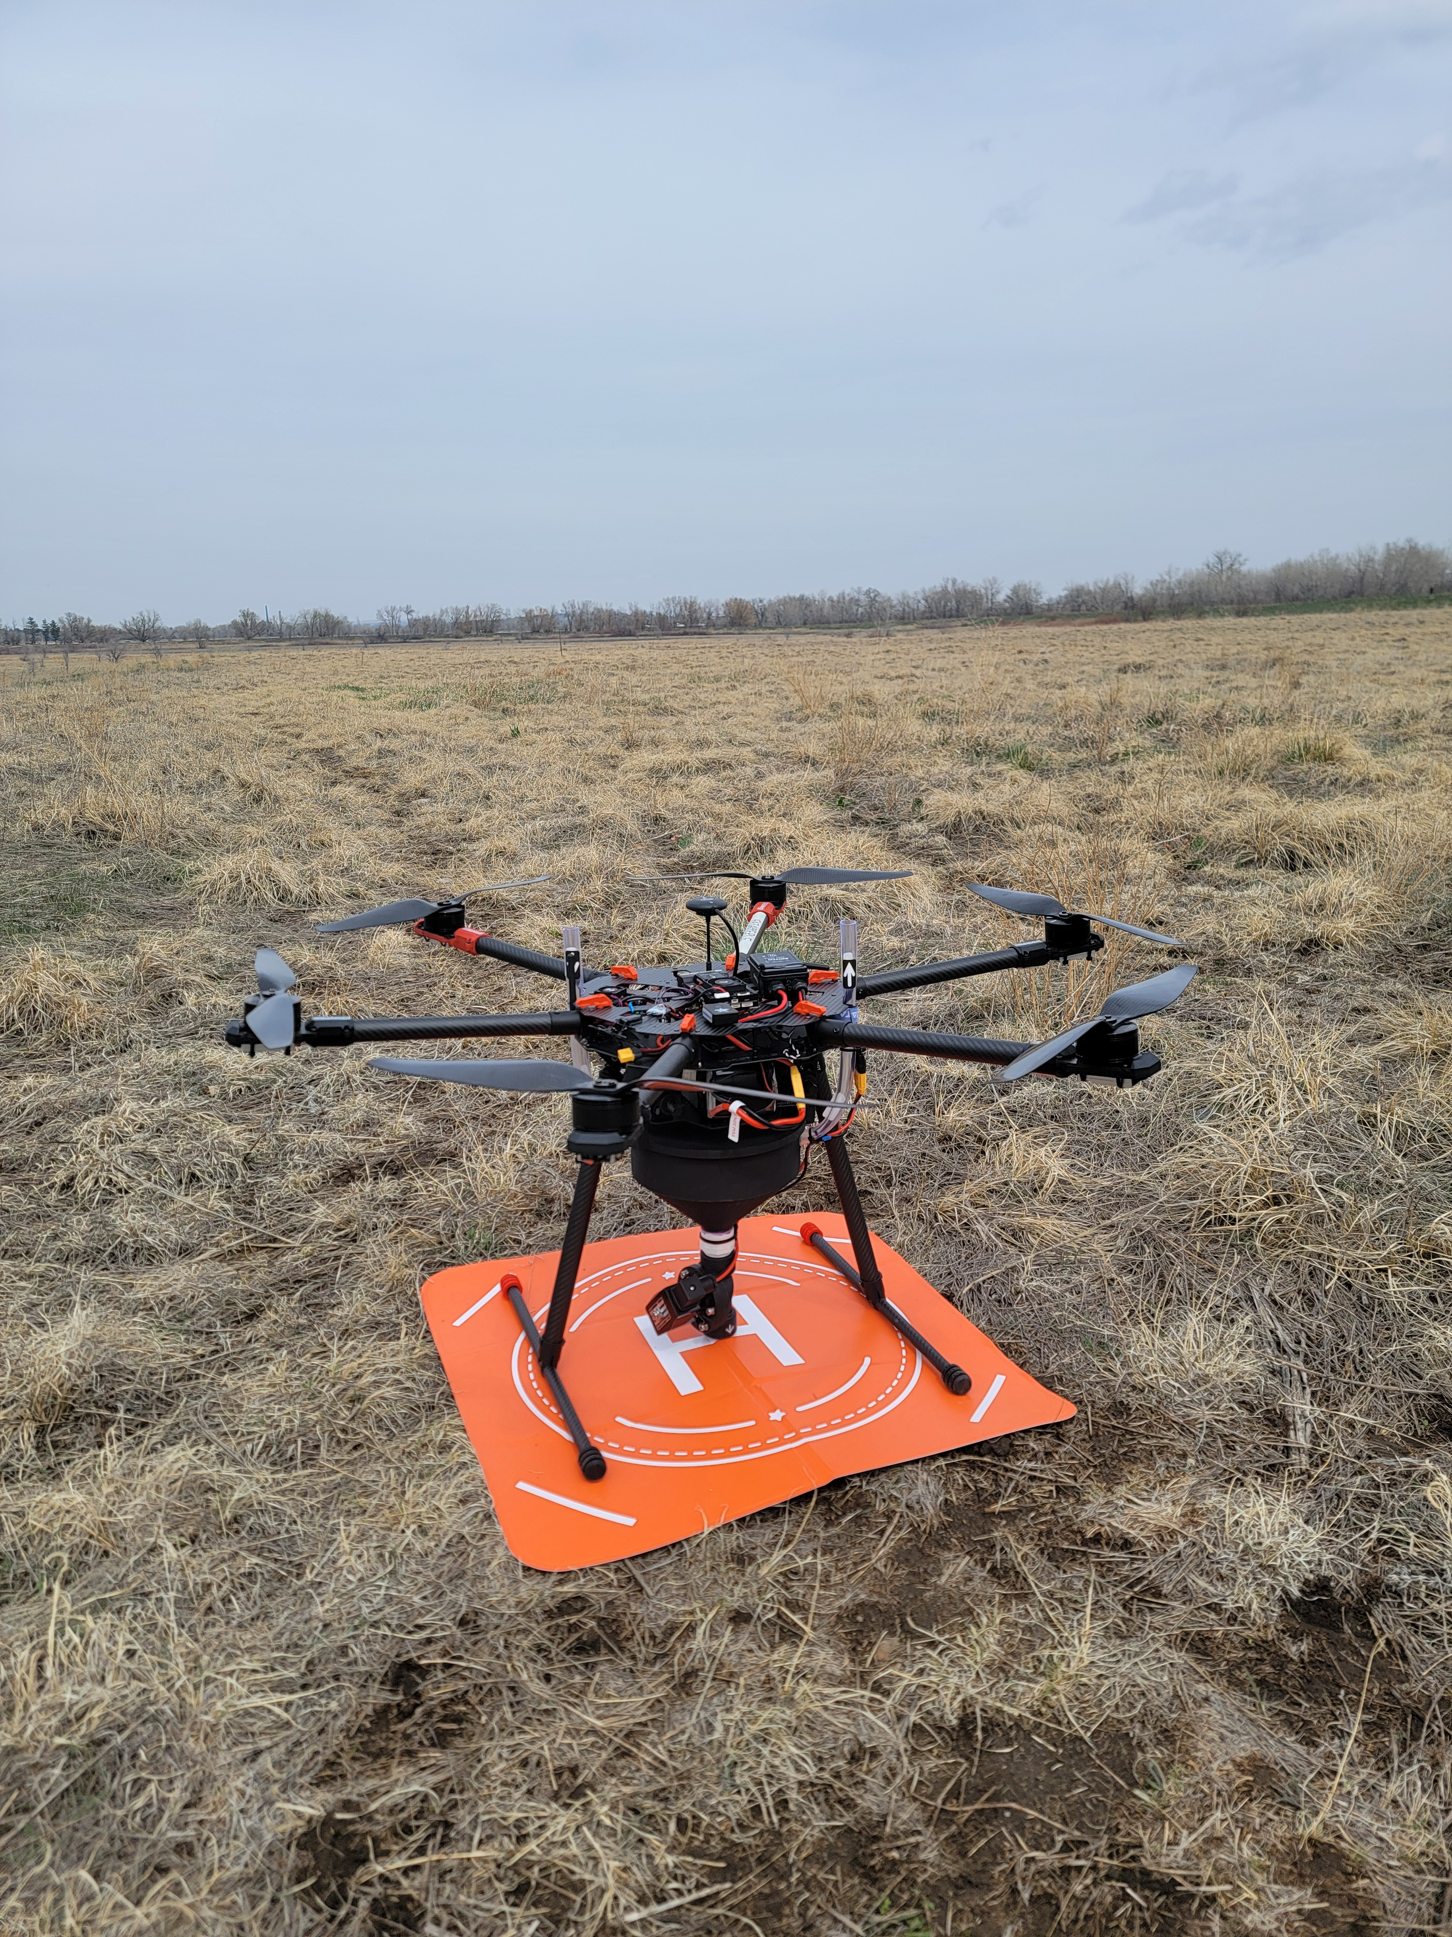
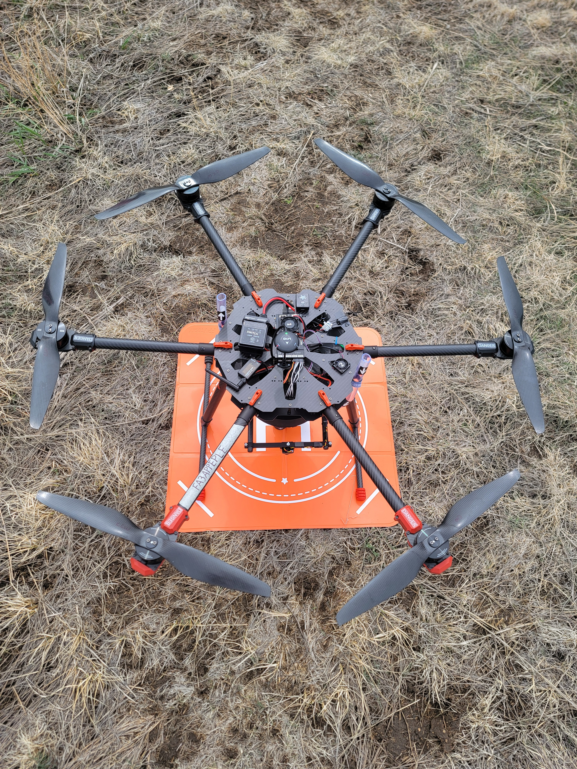
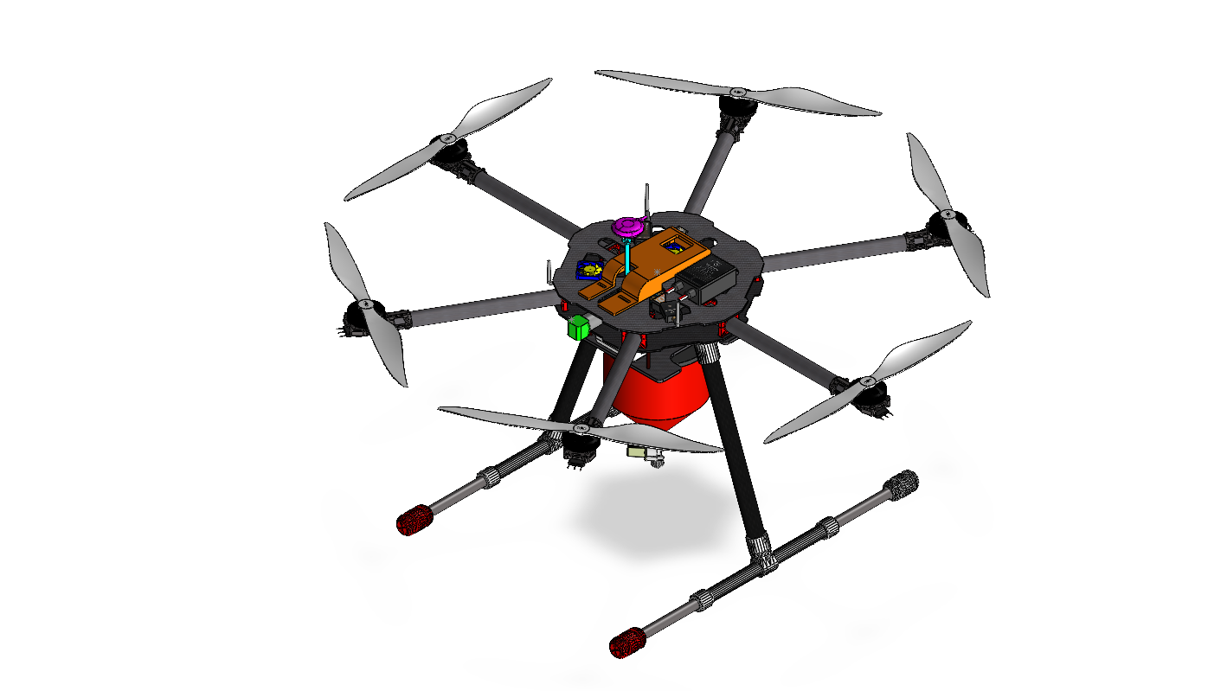
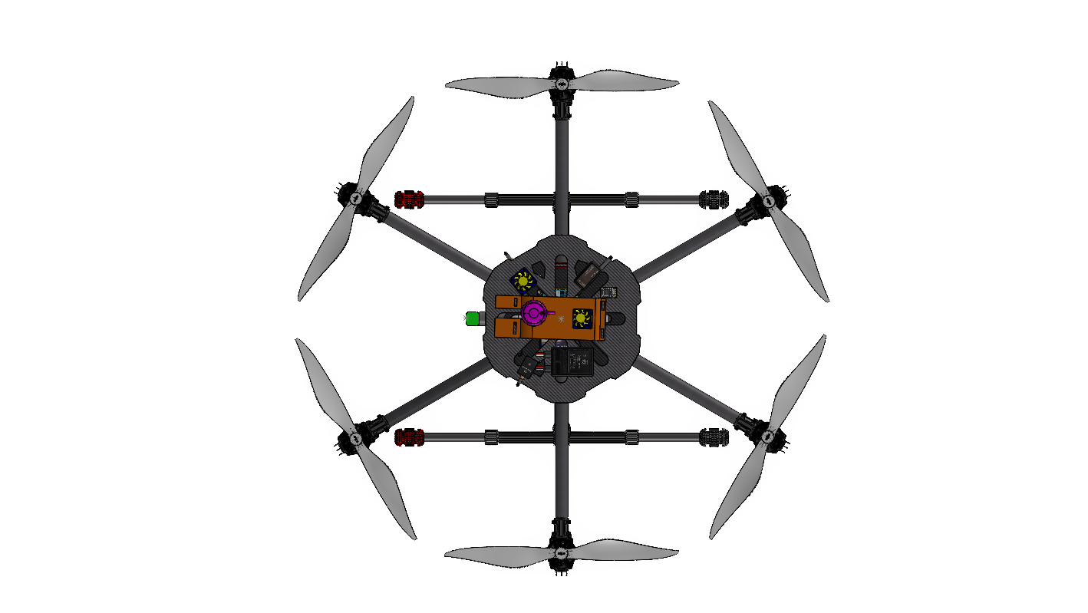
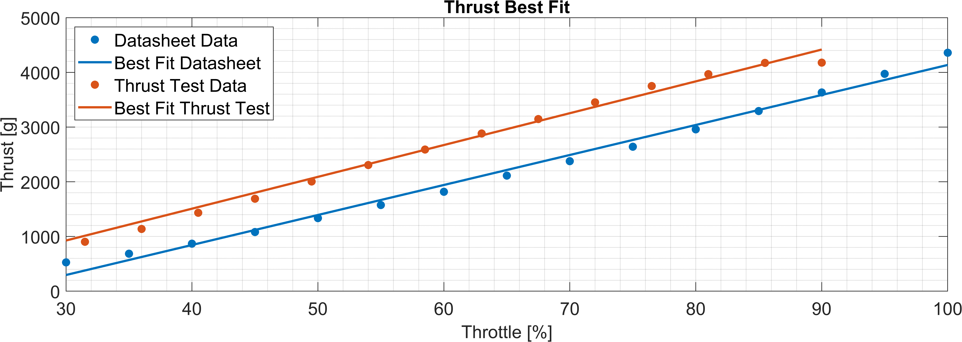
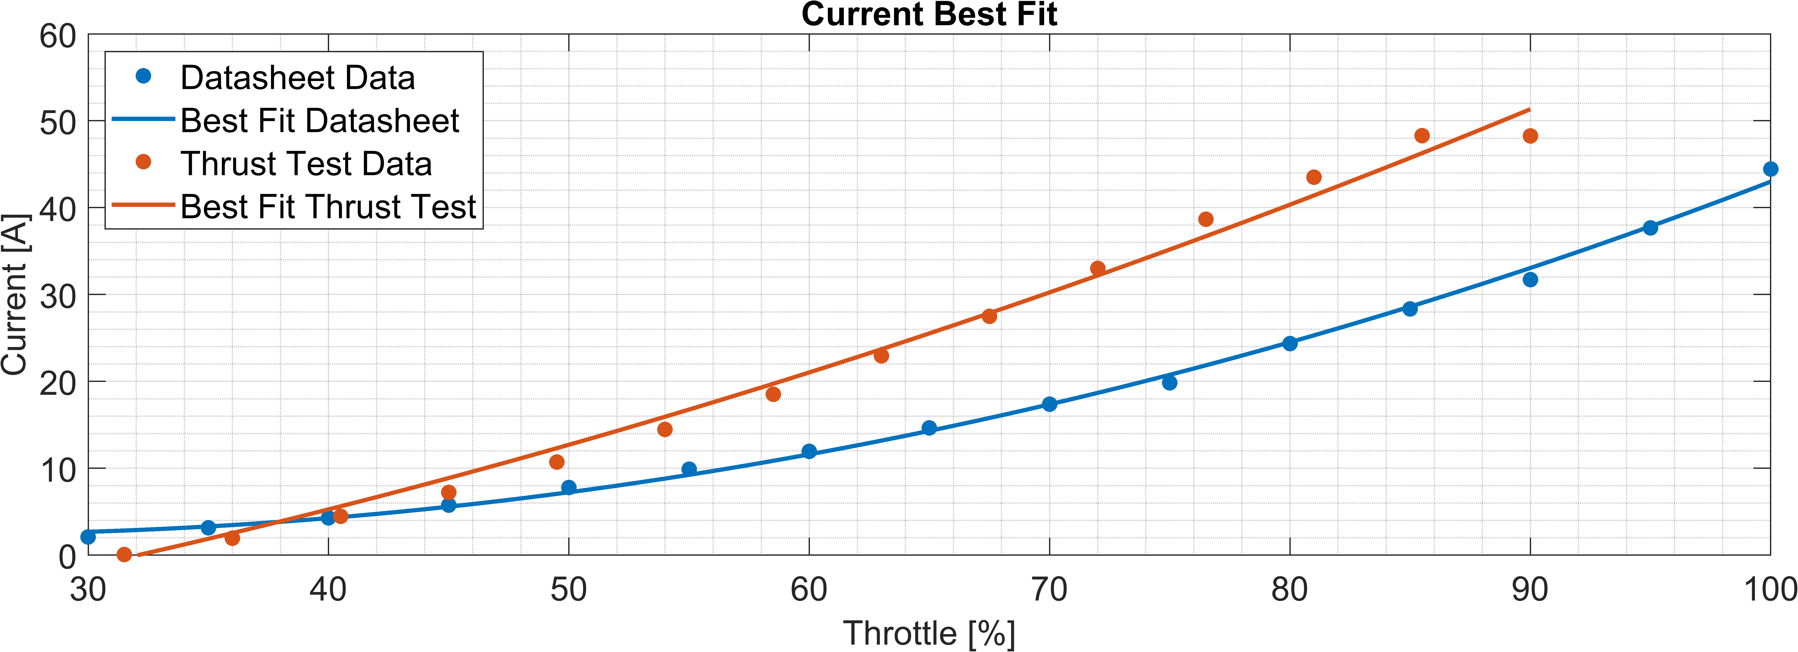
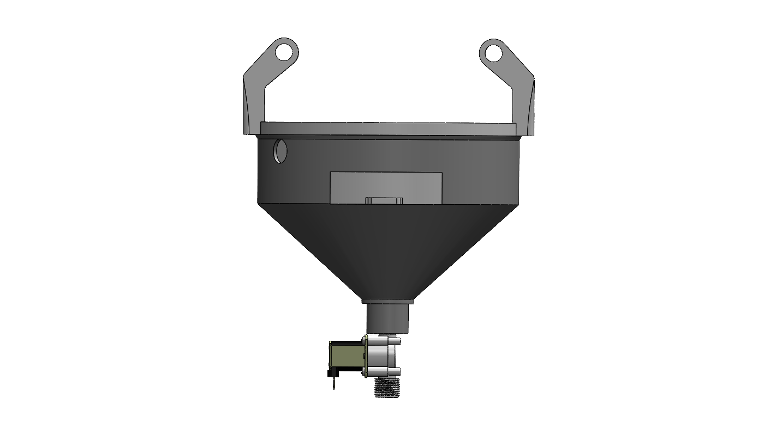
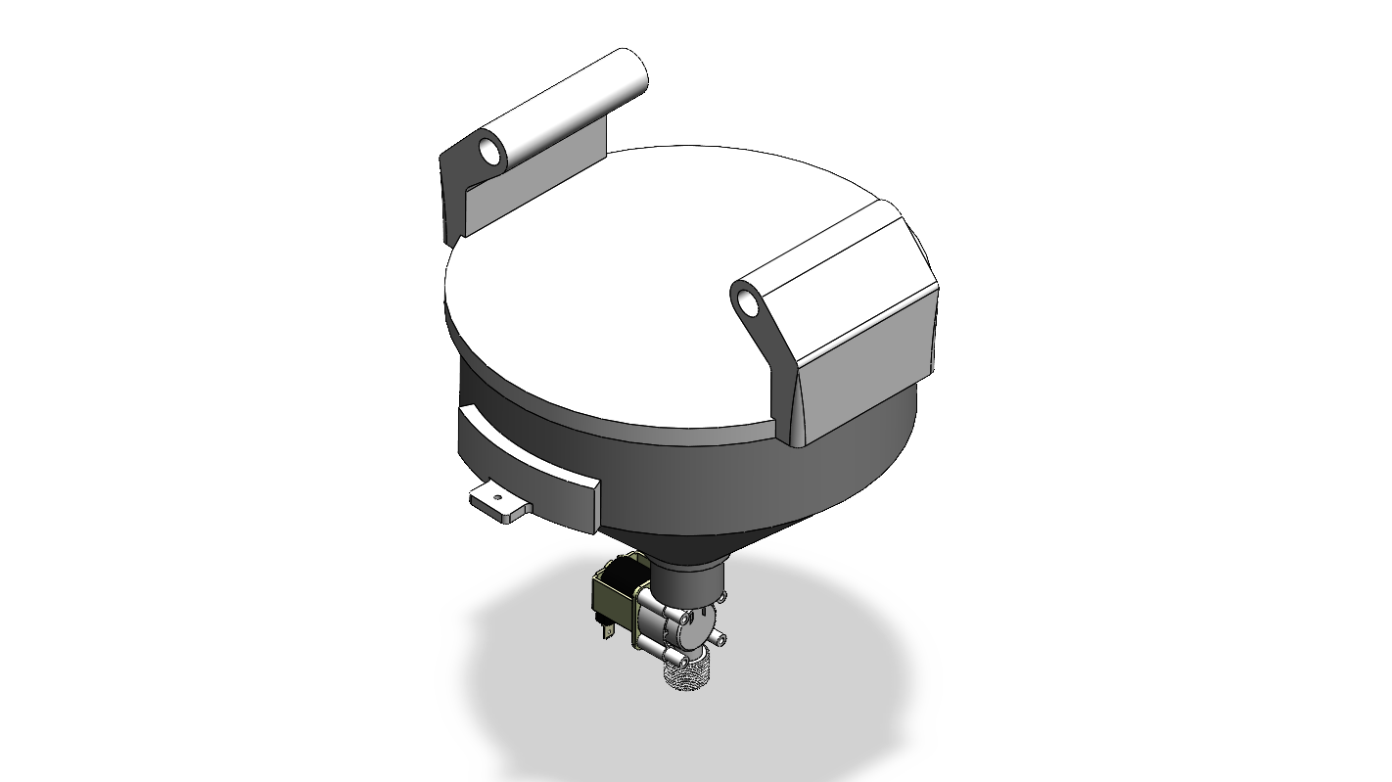
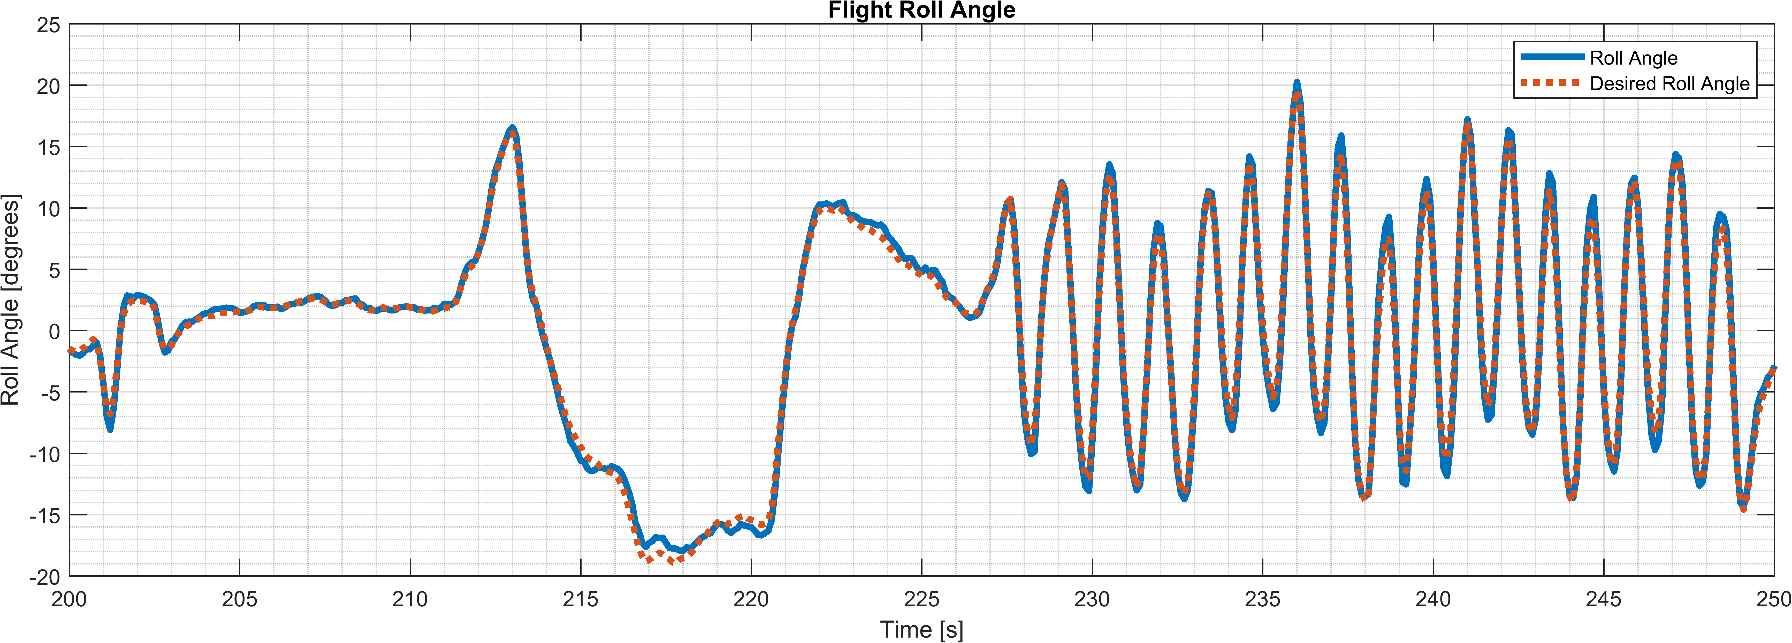
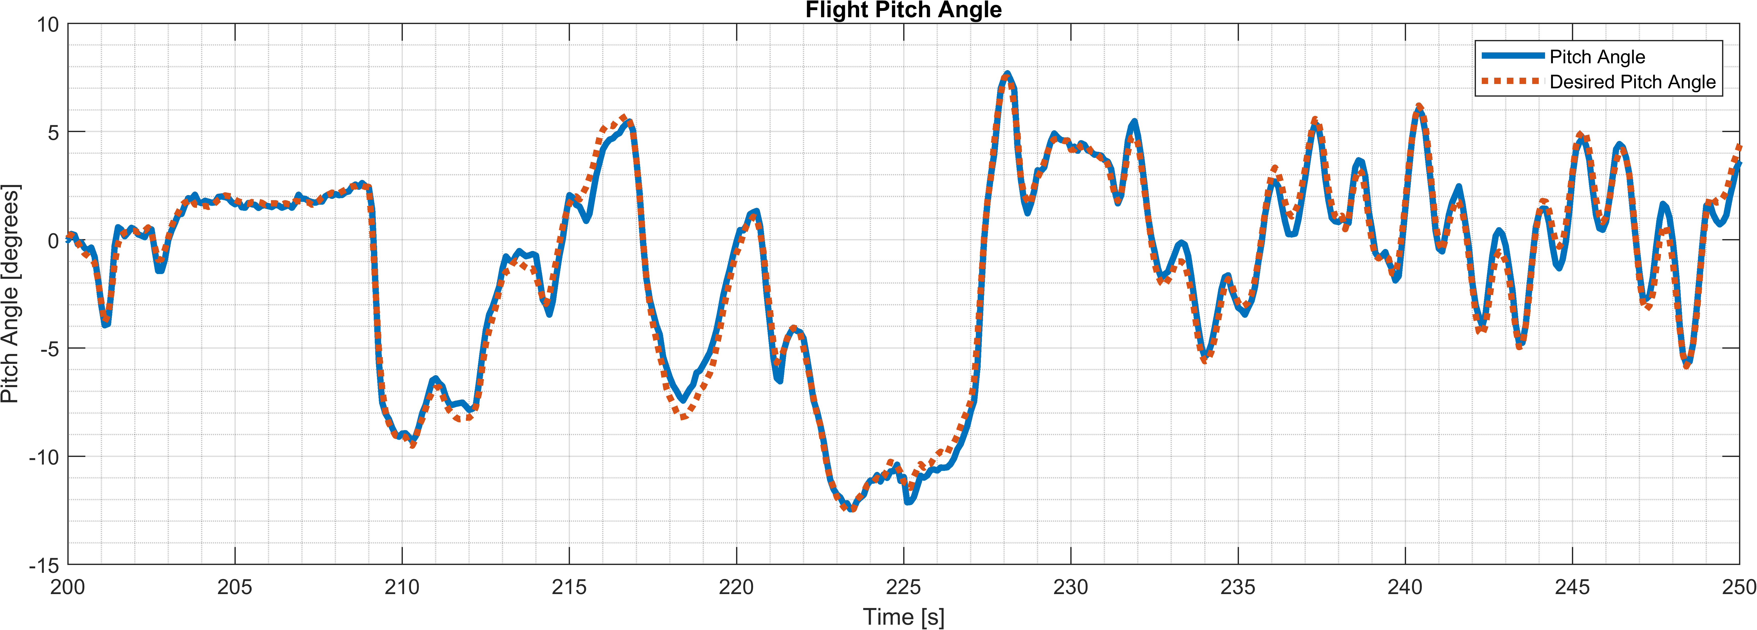
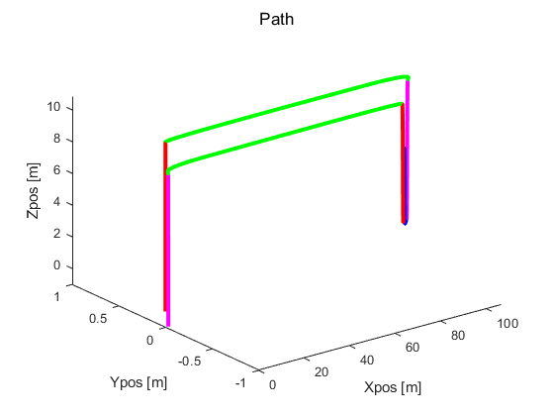
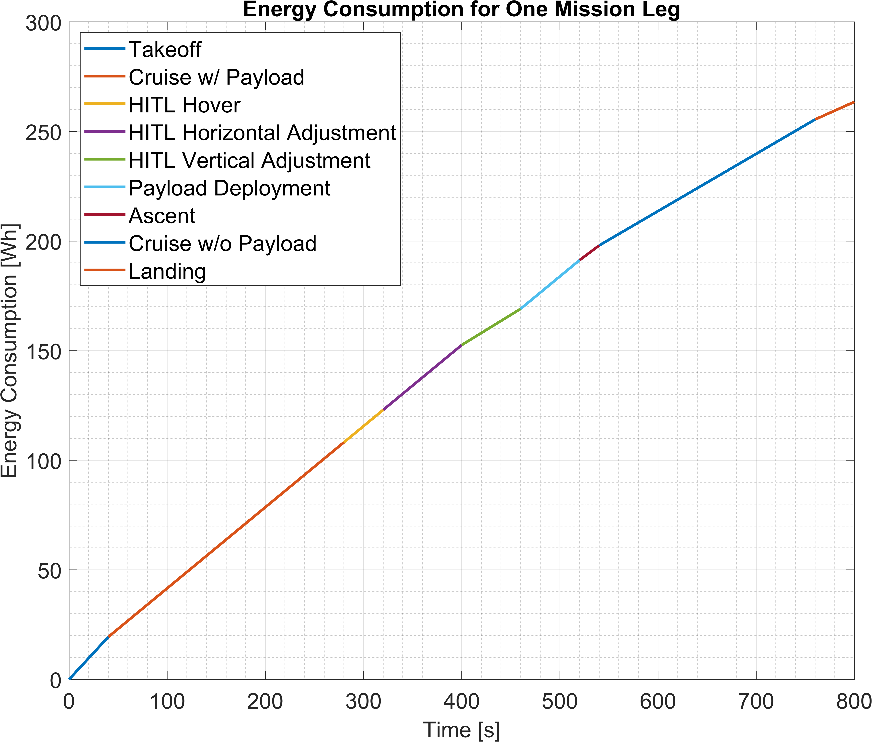
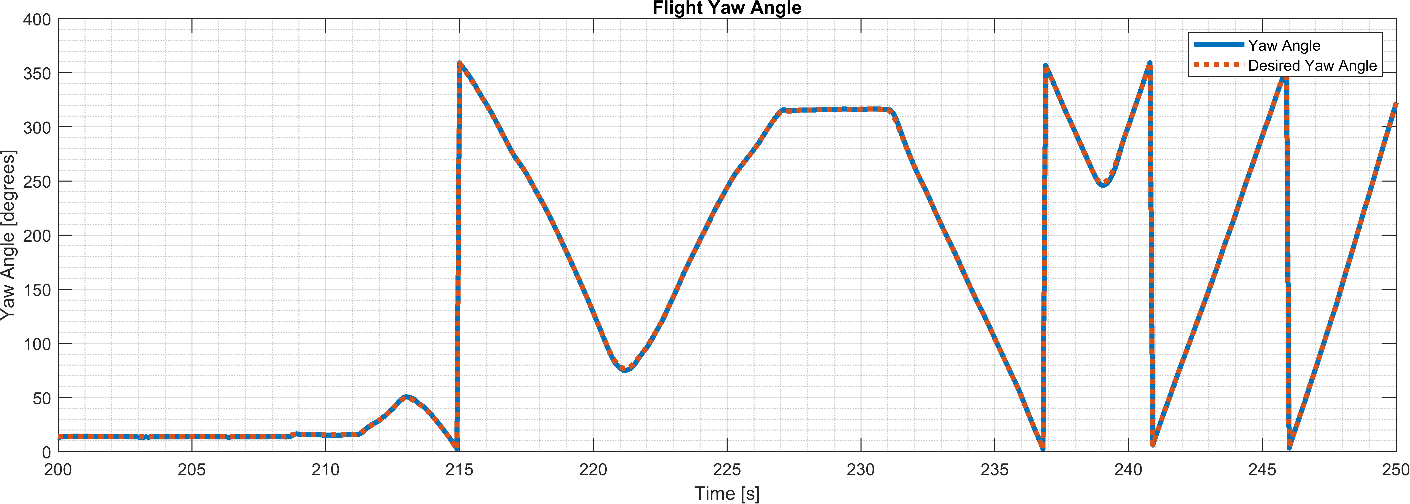
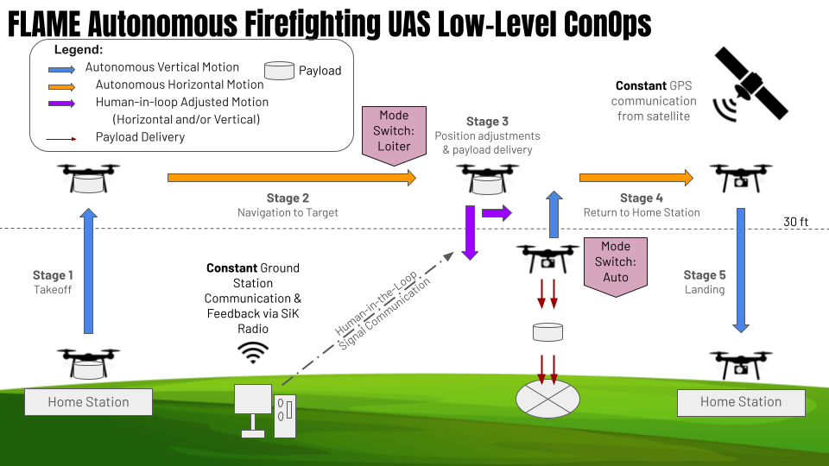
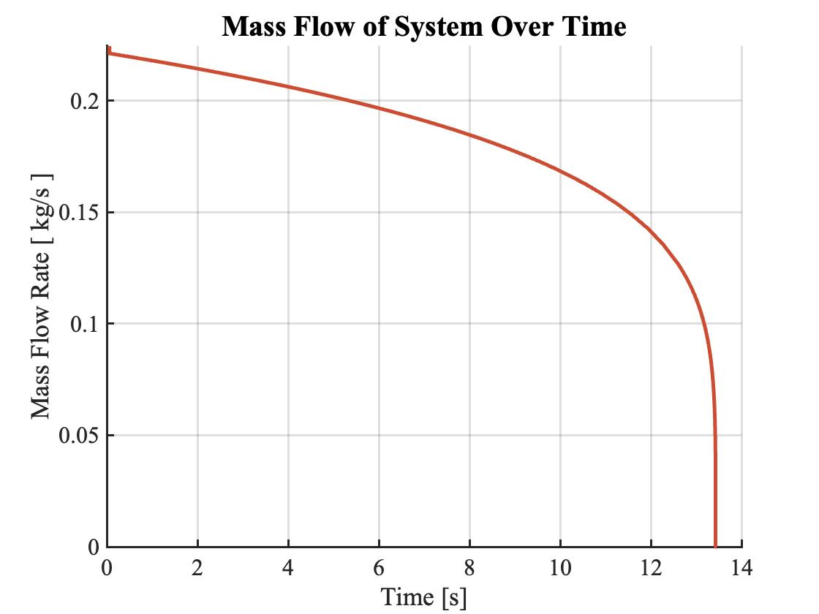
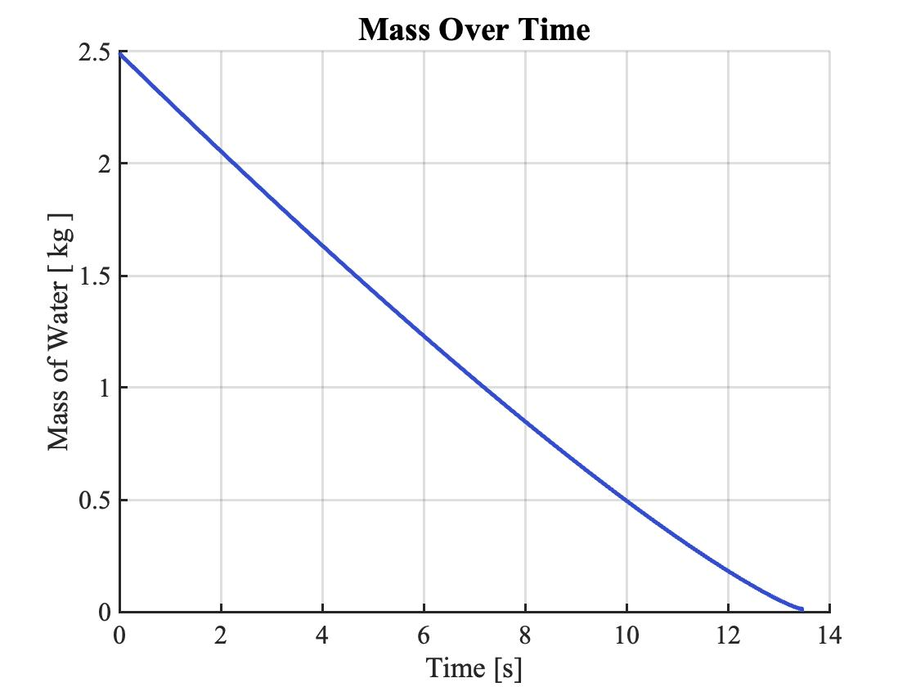
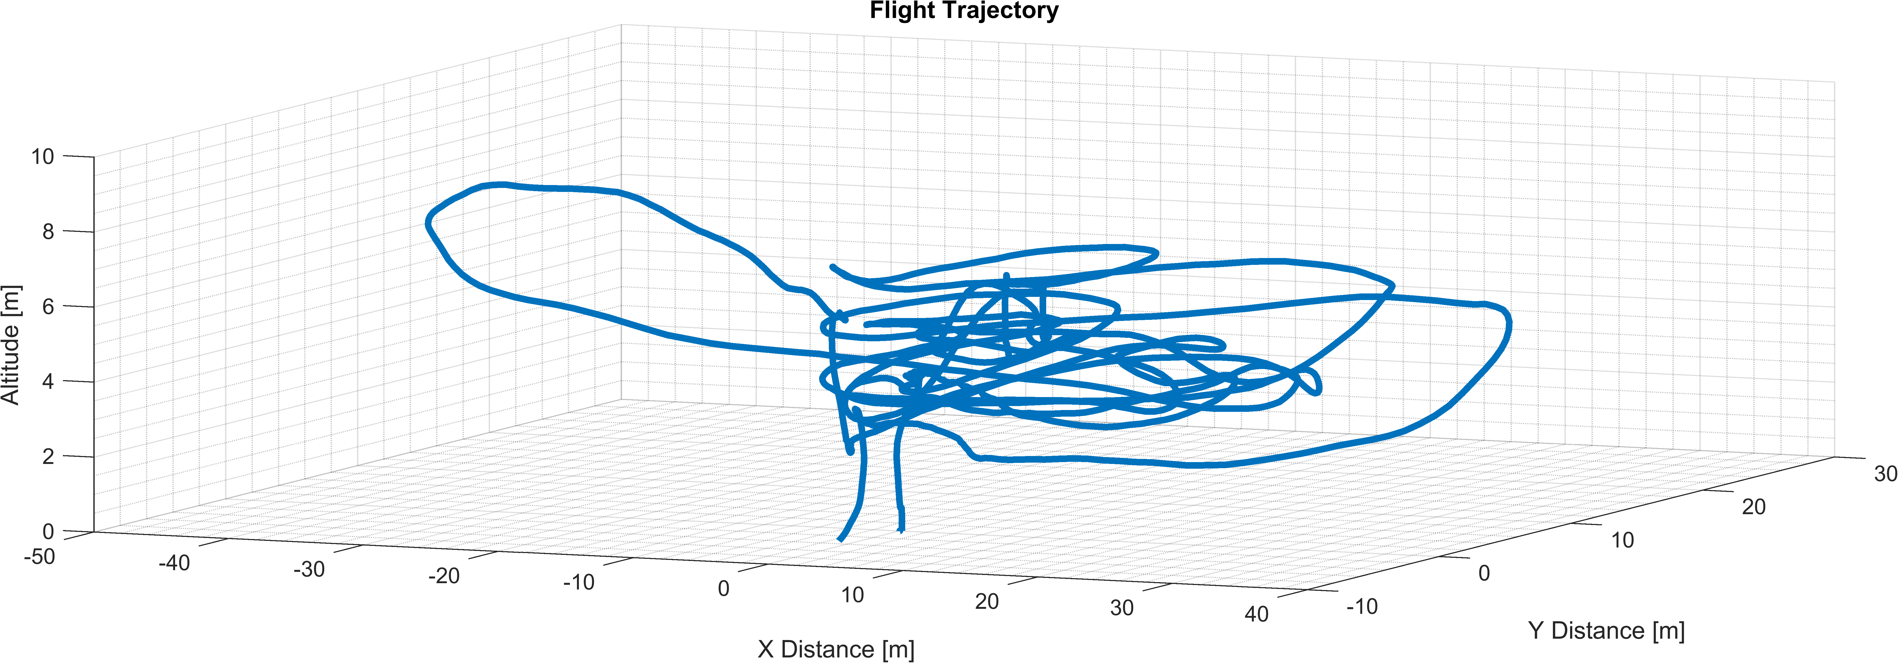

F.L.A.M.E
Fire Limiting Aerial Management Ensemble
Christian Bowman, Maximillian Brown, Ethan Davis, Donovan Gavito, Joshua Geeting, Drew Kane, Ian McCarty, Braden Nelson, Jack Pearse, Alex Putnam, Brady Sivey, Jared Steffen
Design & Methodology
Preliminary Design Trade studies were used to analyze and weigh design decisions to ultimately implement best design choice. A CAD model was developed to estimate COM and MOIs, and a payload container was designed Solenoid Valve Modeling and Simulation Dynamics and control model to simulate vehicle mission and investigate vehicle reaction to a change in inertia with same PID gains. Mass flow rate model to give pilots an idea of length of payload deployment time. Energy consumption model to predict battery size and select motors and propellers based off datasheet values.
Testing & Results
Results: Thrust Fit The test produced results that nearly matched that of the motor datasheet. Most importantly, the thrust was higher than expected, but due to this, the current draw was higher. Despite the increase in current (therefore power), the batteries are still able to conduct the entire mission. Flight Data
Conclusion
General Conceptualized, designed, and built a fully functional prototype in 7 months Testing Achievements Successfully conducted static thrust tests, payload deployment, and day-in-the-life tests Collected data to validate and refine models Future Improvements Increase operational range and time and payload carrying capabilities Increase vehicle weather resistance to fly in stronger wind conditions Implement computer vision and thermal imaging system to make payload deployment autonomous Design a payload integration system to accommodate different payload deployment systems Create a fleet of autonomous firefighting drones to fight larger scale fires
 | Weight | Gravity Release | Ballistic Release | Pump-based | Pressurized tank
Deployment Speed | 0.10 | 3 | 5 | 1 | 3
Weather Resilience | 0.05 | 3 | 4 | 3 | 4
Ease of Deployment Verification | 0.05 | 5 | 5 | 1 | 1
Deployment Stability | 0.15 | 3 | 3 | 4 | 1
Repeated Testability | 0.30 | 4 | 2 | 4 | 2
Reloading Process | 0.05 | 3 | 5 | 3 | 1
Power Consumption | 0.30 | 4 | 4 | 2 | 5
Total: | 1.00 | 3.7 | 3.45 | 2.65 | 2.65
Total Hours Worked (all members) | 2304 Hours
Total Weeks Worked (all members) | 32 Weeks
Total Cost of Materials | $3,489.44
Overall Projected Industry Cost (with overhead) | $144,720.21
Phase | Amount Spent | Allocated Budget | Margin
Phase 1: Testing | $185.40 | $250 $500 | 25.9% Under Budget
Phase 2: Manufacturing | $3113.78 | $3650 $3000 | 14.7% Under Budget
Phase 3: Expo/Other | $31.98 | $100 $500 | 68.0% Under Budget
Total | $3325.17 | $4000 | 16.9% Under Budget
Introduction
Mission Statement Design and build a UAS to demonstrate the utility of remotely operated vehicles in challenging wildfire environments Requirement Overview Some of our most significant requirements include: The system shall be capable of making 3 drops in a 20-minute span The system shall carry and deploy 5 pounds of fire retardant per target location The system shall be able to take off and land autonomously The system shall have a minimum range of 100 meters The system shall utilize human-in-the-loop to navigate from 10 meters RMS accuracy to 1 meter from location of interest Key Subsystems Communication, Control, & Sensing Payload Deployment Propulsion Power
Acknowledgements
CU Faculty Jeff Glusman, Dennis Akos, Matt Rhode, Trudy Schwartz, Kathryn Wingate, Melvin Rafi, Charles Hoke, CU Flight Operations Industry Mentor Jack Elston

